Slide 1


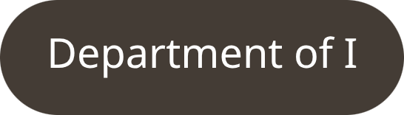
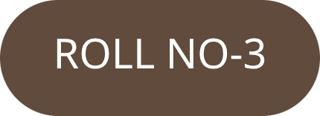
University Course
Registration System
Advanced Programming Project
y
T
3

Slide 2

BACKGROUND
Problem Statement
Time-Consuming Process
Data Management Difficulty
Over-Enrollment Risk
Manual registration workflows consume significant administrative time and resources, creating bottlenecks across departments.
Tracking student–course relationships manually is error-prone and difficult to scale as enrollment grows.
Without capacity enforcement, courses can exceed maximum student limits, disrupting academic planning.
Human Error Risk
Without automated validation, data entry mistakes lead to inconsistencies in student and course records.
No Validation System
Absence of structured input checks allows invalid or duplicate data to enter the system unchecked.

Slide 3

GOALS
Objectives
1
Automate Course Registration
Eliminate manual steps by building a fully automated registration flow driven by a menu interface.
2
Reduce Manual Workload
Shift administrative effort away from repetitive data tasks toward higher-value academic activities.
3
Ensure Proper Validation
Enforce input rules at every stage to guarantee data integrity and prevent invalid entries.
4
Maintain Structured Data
Organise student, course, and enrollment records in a coherent, easily queryable object model.
5
Build a Scalable System
Design with extensibility in mind so future features — GUI, database, web — can be added without restructuring.

Slide 4
DESIGN
System Overview & Core Features
About the Application
Key Features
A console-based Java application with a menu-driven interface, built entirely on Object-Oriented Programming principles. It handles students, courses, and enrollments in a clean, modular structure.
Add Student
Create Course
Register new students with validated ID and name fields.
Define new courses with code, title, and enrollment capacity.
Console-Based Java
Menu-Driven UI
Runs entirely via terminal — no GUI dependency required.
Numbered options guide users through all system operations.
Enroll Student
View Students & Courses
Link a student to a course with over-enrollment prevention.
Display all stored records in a formatted console output.
OOP Architecture
Input Validation
Fully built on Java classes, inheritance, and encapsulation.
Every entry point enforces rules to catch and reject bad data.

Slide 5

PROGRAMMING CONCEPTS
OOP Concepts Used
Abstraction
Inheritance
Polymorphism
The User class defines the abstract blueprint — exposing only essential attributes while hiding internal complexity from the caller.
Both Student and Instructor extend User, reusing shared properties and enabling specialised behaviour per type.
The overridden display() method behaves differently in each subclass, demonstrating runtime polymorphism cleanly.
Encapsulation
Exception Handling
All data fields are kept private inside their respective classes, accessed only through controlled getter and setter methods.
try-catch blocks wrap all user inputs, catching invalid data gracefully and keeping the system running without crashes.

Slide 6
ARCHITECTURE
System Architecture & Class Structure
MVC-Inspired Design
Class Hierarchy
The system follows a clean separation of concerns, loosely modelled on the Model–View–Controller pattern for maintainability and extensibility.
RegistrationManager
Enrollment
Model
Classes — User, Student, Course, Enrollment hold all domain data and business logic.
Course
Student (extends User)
Controller
User (Base Class)
RegistrationManager coordinates operations between classes — adding, enrolling, and retrieving records.
View
Main class renders the console menu and routes user selections to the appropriate controller methods.

Slide 7
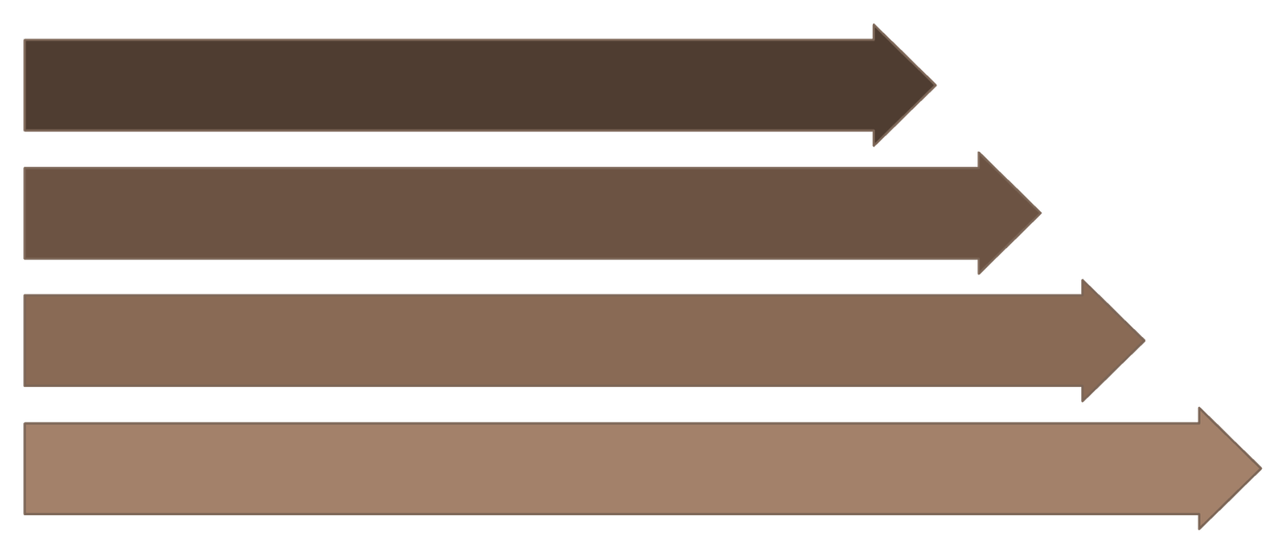
EXECUTION FLOW
Workflow & Error Handling
Select Option
Take Input
Validate Input
Perform Operation
Every user interaction follows this strict five-step pipeline, ensuring no operation is executed without passing the validation gate first.
Invalid Input Handling
Crash Prevention
Smooth Execution
Non-numeric entries, empty fields, and out-of-range values are caught before reaching business logic.
try-catch blocks around all I/O operations prevent unhandled exceptions from terminating the program.
Users are prompted to re-enter data on failure, keeping the session active and feedback clear.

Slide 8
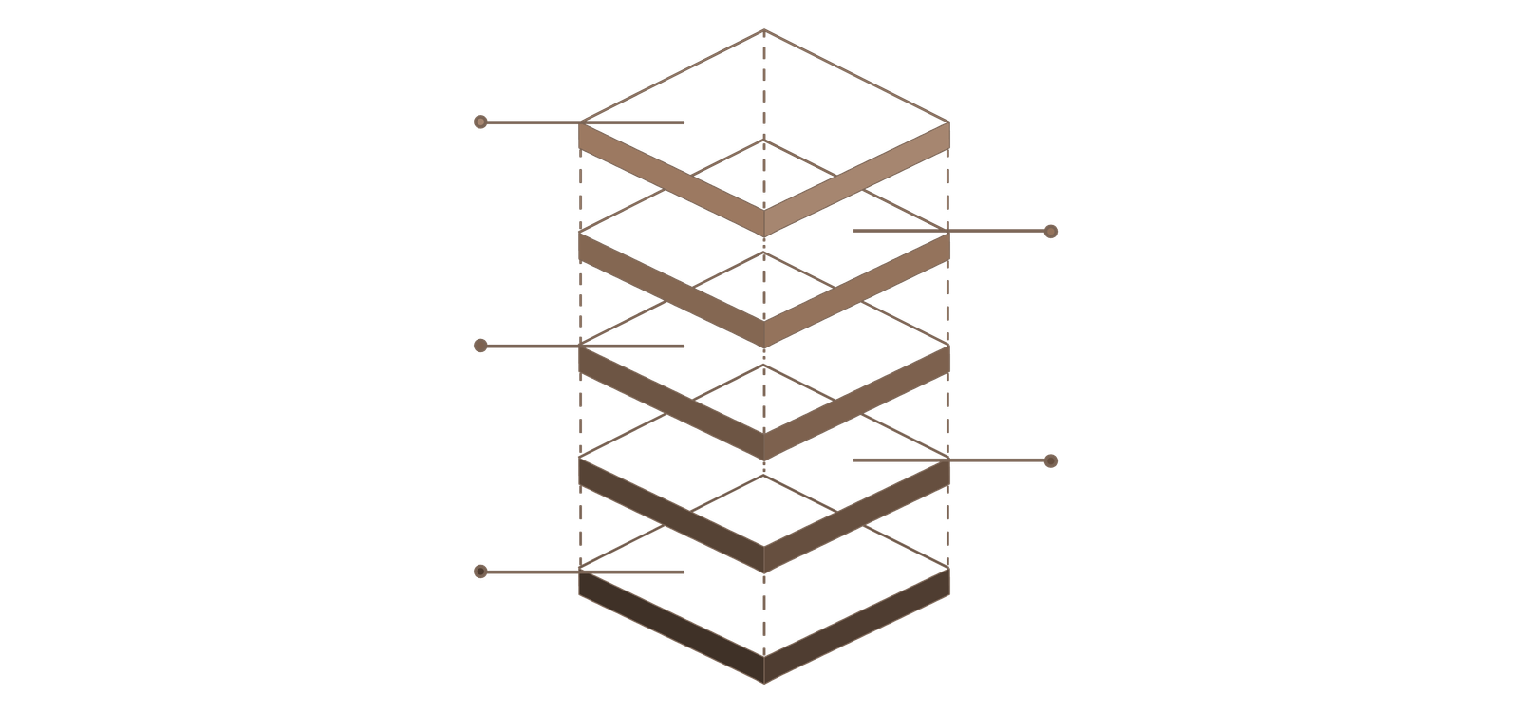
UML DIAGRAM
Class Diagram Overview
RegistrationManager
addStudent(), createCourse(), enrollStudent(), viewAll()
Enrollment
student, course, date; enroll()
Course
courseId, title, capacity; getDetails()
Student
extends User; courseList; display()
User
userId, name; display()
The class hierarchy begins with User as the base, extended by Student. Course and Enrollment model the academic data layer, while RegistrationManager orchestrates all system operations — forming a clean, layered OOP architecture.

Slide 9
SAMPLE OUTPUT
Console Menu & Sample Interaction
Main Menu
===== Course Registration System =====
1. Add Student
2. Create Course
3. Enroll Student
4. View All Students
5. View All Courses
6. Exit
======================================
Enter your choice: _
Sample — Adding a Student
Enter Student ID: S101 Enter Student Name: Sarbik Chakraborty

Slide 10

SUMMARY
Conclusion & Future Scope
What Was Achieved
Future Scope
Efficient & Structured System
A fully functional console application that automates registration end-to-end.
GUI Layer
Reduced Manual Effort
Migrate the console interface to Java Swing or JavaFX for a visual, user-friendly experience.
All core workflows — adding, enrolling, viewing — are handled programmatically.
OOP Demonstrated
Database Integration
Abstraction, inheritance, polymorphism, encapsulation, and exception handling all applied in context.
Connect to MySQL via JDBC to persist records beyond runtime and support large-scale data.
Easily Extensible
Web-Based System
Modular design means new features slot in without rearchitecting the existing codebase.
Expose functionality via a Spring Boot REST API with a browser-accessible front end.
Multi-User Support
Add authentication and role-based access for students, instructors, and administrators.

